Slide 1




PEV114
ADVANCED -VERBAL ABILITY
Zero Lecture

Slide 2




Objectives
To familiarize students with the prevalent topics featured in placement assessments.
To cultivate proficiency in rapidly tackling the verbal ability segment of said assessments.
To equip students comprehensively for placement scenarios.
To elevate skillsets by instilling unwavering confidence

Slide 3


L-T-P and Credit details
L (Lecture)-2
T (Tutorial)-0
P (Practical)-2
Credits: 03

Slide 4
Course Outcomes
CO1:: employ communication strategies by critically assessing content for clarity, coherence, and persuasiveness to excel in society
CO2:: demonstrate the application of grammatical rules and language conventions by identifying and correcting sentence errors
CO3:: analyze language proficiency in reading comprehension to improve overall understanding and communication skills

Slide 5
Course Outcomes
CO4:: assess complex text structures and vocabulary to create coherent narratives and enhance life skills
CO5:: design engaging peer presentations with interactive elements to effectively communicate complex ideas
CO6:: compose speeches and well-structured written compositions, showcasing effective communication skills in speaking and writing

Slide 6
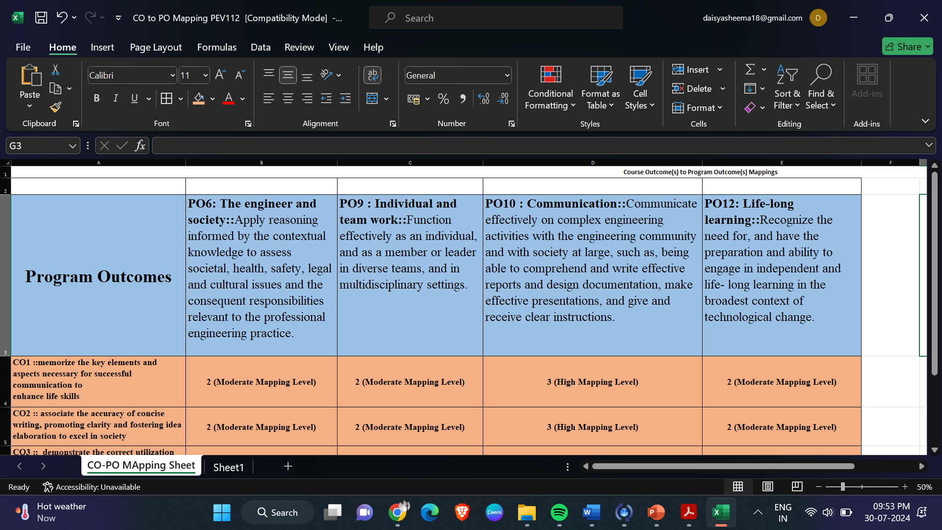
Program Outcomes as specific to the course: PO6,9,10,12

Slide 7
CO-PO Mapping
Outcomes | CO1:: employ communication strategies by critically assessing content for clarity, coherence, and persuasiveness to excel in society | CO2:: demonstrate the application of grammatical rules and language conventions by identifying and correcting sentence errors | CO3::analyze language proficiency in reading comprehension to improve overall understanding and communication skills | CO4:: assess complex text structures and vocabulary to create coherent narratives and enhance life skills | CO5:: design engaging peer presentations with interactive elements to effectively communicate complex ideas | CO6:: compose speeches and well-structured written compositions, showcasing effective communication skills in speaking and writing
PO6: The engineer and society: Apply reasoning informed by the contextual knowledge to assess societal, health, safety, legal and cultural issues and the consequent responsibilities relevant to the professional engineering practice. | 2(Moderate) | 2(Moderate) | 2(Moderate) | 2(Moderate) | 2(Moderate) | 2(Moderate)
PO9 : Individual and Team Work: Function effectively as an individual and as a member or leader in diverse teams and in multidisciplinary settings. | 2(Moderate) | 2(Moderate) | 2(Moderate) | 2(Moderate) | 2(Moderate) | 2(Moderate)

Slide 8
CO-PO Mapping
Outcomes | CO1:: employ communication strategies by critically assessing content for clarity, coherence, and persuasiveness to excel in society | CO2:: demonstrate the application of grammatical rules and language conventions by identifying and correcting sentence errors | CO3::analyze language proficiency in reading comprehension to improve overall understanding and communication skills | CO4:: assess complex text structures and vocabulary to create coherent narratives and enhance life skills | CO5:: design engaging peer presentations with interactive elements to effectively communicate complex ideas | CO6:: compose speeches and well-structured written compositions, showcasing effective communication skills in speaking and writing
PO10:Communicate effectively on complex engineering activities with the engineering community and with society at large, including comprehension and writing effective reports and design documentation, making effective presentations, and giving and receiving clear instructions. | 3 (High mapping level) | 3 (High mapping level) | 3 (High mapping level) | 3 (High mapping level) | 3 (High mapping level) | 3 (High mapping level)
PO12:Lifelong Learning:Recognize the need for, and have the preparation and ability to engage in independent and lifelong learning in the broadest context of technological change. | 2(Moderate) | 2(Moderate) | 2(Moderate) | 2(Moderate) | 2(Moderate) | 2(Moderate)

Slide 9
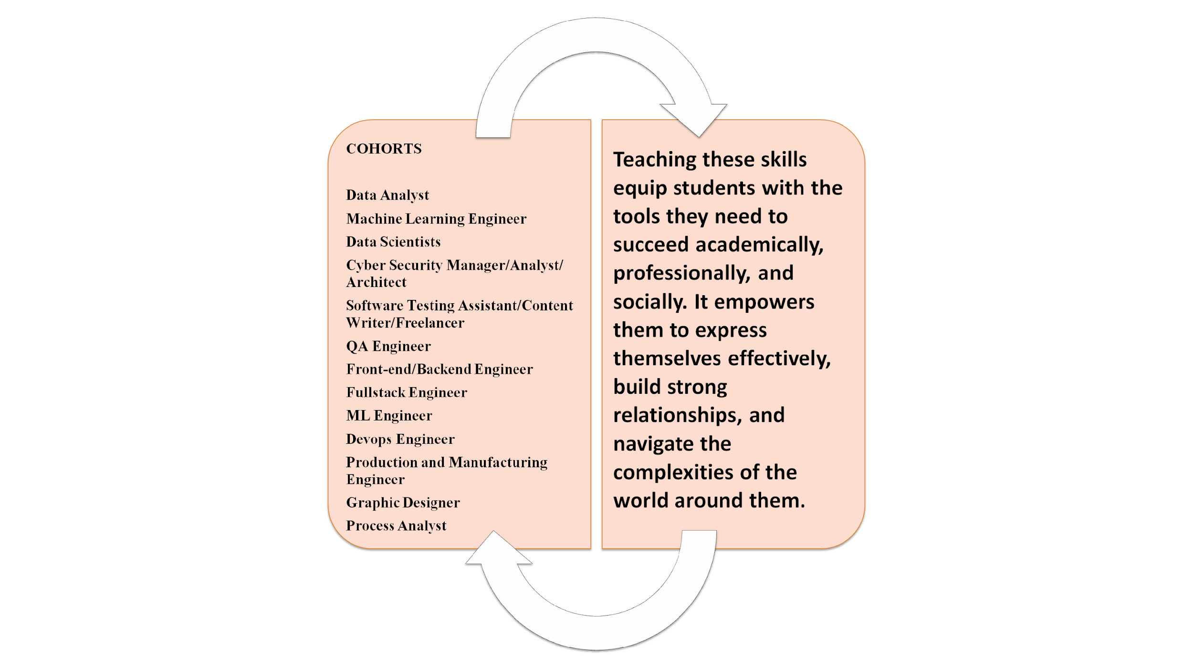


Slide 10
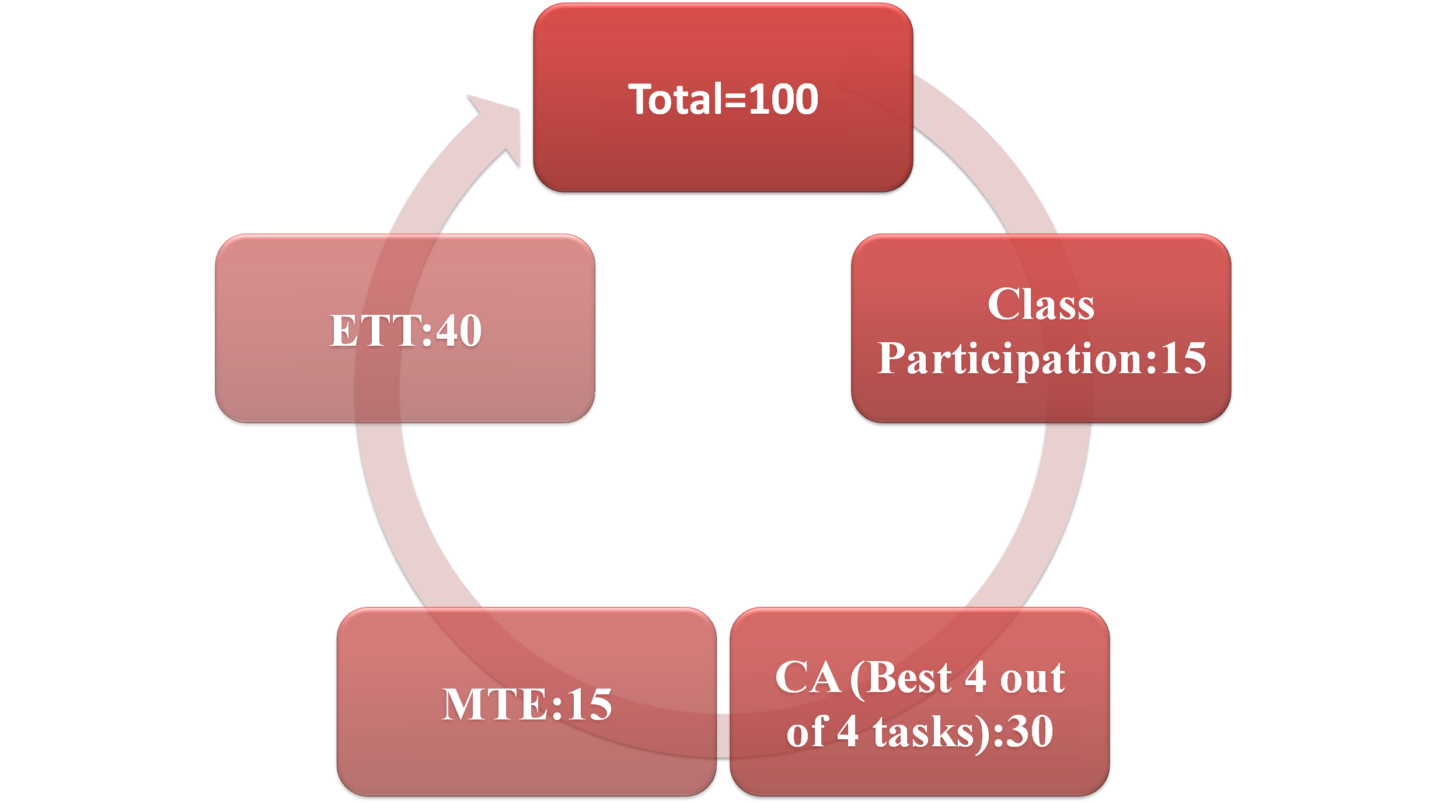

Course Assessment Model

Slide 11


Course Content
1
Voice and accent
2
Sentence correction
3
Vocabulary & Sentence completion
4
Verbal presentation & Essay writing
5
Reading comprehension
6
Para jumble

Slide 12


Course Content:
Unit 1 details
Voice and accent
vowels and consonants, manner of articulation, syllable, stress and intonation, phonic drills, expressive elocution

Slide 13
Course Content:
Unit 2 details
Sentence correction
introduction of the concept, error correction based on modifiers, error correction based on parallelism, error correction based on comparison, error correction based on participles

Slide 14
Course Content:
Unit 3 details
Vocabulary
idiomatic expressions, antonym and synonyms, vocabulary application in situational verbal skills
Sentence completion
introduction to sentence completion based on phrases and clauses, various exercise sentence completion based on phrases and clauses

Slide 15
Course Content:
Unit 4 details
Verbal presentation & Essay writing
thesis statement, essay statement, writing introduction, writing body paragraphs, concluding the essay, useful phrases for essay writing, verbal presentation of academic and professional topics

Slide 16
Course Content:
Unit 5 details
Reading comprehension
types of questions in reading comprehension, introduction to reading comprehension questions based on inference, main idea, reference based exercises based on inference, vocabulary based, comprehension dialogue

Slide 17
Course Content:
Unit 6 details
Para jumble:
types of para jumbles, fixed and movable para jumbles, verbal clues to solve para jumbles, logical clues to solve para jumbles
Interview Skills: role of passive instructions, useful phrases and clauses, situational competency, selective and attentive listening, panel discussion scenarios

Slide 18
Course Content:
Unit 7 details
List of Practicals:
Practice worksheets on grammar topics:
practice session on error identification and correction
worksheets completion based on comprehension and missing text,
vocabulary games and practice sheets,
structural variation of sentences for meaning creation,
recognition of the word relationship.

Slide 19
Course Content:
Unit 7 details
Reading skills
•practice sessions on reading comprehension
Writing skills
•functional aspects of essay writing

Slide 20
Course Content:
Unit 7 details
Speaking skills
Phonic drill based on sounds, stress and intonation
JD: understanding JD, adjective placement and JD, summarizing and articulating JD
CV: connection between CV and JD, various parts of CV, CV justification, company-specific key words, adjective and adverb placement
Interview skills: role of passive instructions, useful phrases and clauses, situational competency,
GD: Group interaction activities, role plays and simulations

Slide 21
Star Course-Selection Criteria
Course focused on enhancing the communication skills for professional and academic success.
Improved speaking abilities to excel in presentation and public speaking.
Develop writing proficiency for clear and effective documentation.
Build strong interpersonal skills to foster professional relationships.
Pedagogical Initiatives
These interactive activities not only make learning more enjoyable but also encourage active participation and collaboration among students.
Flipped Classroom: Utilizing the flipped classroom model, students are introduced to new content outside of class through video lectures, reading assignments, and other preparatory materials. This approach allows classroom time to be dedicated to interactive discussions, practical exercises, and hands-on activities that reinforce and apply the learned concepts.
Online Platforms for Practice: Various online platforms are employed to provide students with ample opportunities to practice their communication skills. These platforms offer exercises, simulations, and real-time feedback, enabling students to refine their abilities in a flexible and convenient manner.
Implementation strategies to increase the interaction of students.

Slide 22


Star course: Execution Strategies
STEEP UP:
The STEEP UP Role Play activity involves students in a structured approach to developing and articulating ideas by analyzing topics through seven key aspects: Social, Technology, Economy, Environment, Political, Universal, and Personal. Students will be divided into small groups, assigned a topic, and brainstorm for a few minutes to analyze their topic from each STEEP UP perspective. They will then create a role play scenario representing different viewpoints, such as a tech company executive or a government official, to enhance critical thinking, articulation skills, and prepare for real-world scenarios through thorough analysis and structured communication.

Slide 23
Execution Strategies
I Am the Tech Influencer:
In this activity, students will present their projects, internships, and certifications by mimicking the presentation style of tech influencers, focusing on elaborating ideas, highlighting key features, discussing benefits, sharing personal experiences, and working on voice modulation, clarity, intonation, and pronunciation; they will select a topic, prepare content emphasizing these aspects, deliver their speeches in front of the class, and, if possible, have their presentations recorded for further review and feedback.

Slide 24
Execution Strategies
Peer Teach-Back Verbal Mastery:
In this pair activity, students will engage in preparing and delivering detailed presentations on core-based topics assigned beforehand. They will focus on ensuring grammatical accuracy and clear sentence construction throughout their presentations. Peers will actively evaluate each presentation based on criteria such as clarity, engagement, and grammatical correctness, providing constructive feedback to enhance learning. This structured approach fosters collaborative learning and thorough assessment of language proficiency, effectively preparing students for confident and effective communication in diverse contexts.

Slide 25
Execution Strategies
Bamboozled Sentence Correction Challenge:
In the "Bamboozled Sentence Correction Challenge," students will engage in a lively and competitive learning experience focused on improving sentence correction skills. Introduced by the faculty through the Bamboozled gaming website, students will participate in teams without the need for personal gadgets. The faculty will project sentence correction games on a screen using a projector, where teams will take turns correcting sentences displayed. The goal is for each team to earn points by accurately identifying and fixing grammatical errors in sentences. This interactive approach not only enhances students' grammatical proficiency but also fosters teamwork and engagement in a fun classroom environment.

Slide 26
Execution Strategies
Mercer Mettle Quizizz Vocabulary Builder:
In the "Quizizz Vocabulary Builder" activity, students will actively engage in enhancing their vocabulary through interactive quizzes on the Quizizz platform. Introduced by the faculty, students will individually participate using their mobile phones or laptops, accessing quizzes tailored to lesson objectives that focus on new words, synonyms, and antonyms. The faculty will project the Quizizz interface on a screen for monitoring and display of students' progress in real-time. Students will answer quiz questions designed to reinforce vocabulary concepts, aiming to improve their language skills in a dynamic and competitive learning environment. Immediate feedback from the faculty based on the platform's data will further support students in consolidating their understanding and usage of vocabulary words.

Slide 27
Execution Strategies
Situational Vocabulary Elocution Exercise:
In this activity, students will engage in applying situational vocabulary to respond effectively to various prompts designed to simulate real-life scenarios. They will demonstrate their understanding and usage of advanced vocabulary words within specific contexts, such as problem-solving dilemmas in projects or handling challenging situations. Prior to the activity, students will be provided with a vocabulary list and situational prompts to prepare thoughtful and detailed responses. Through this process, students will develop the ability to articulate their thoughts clearly and confidently, preparing them for HR-related situational and attitude-based interview questions by showcasing their problem-solving skills, resilience, and creative thinking in practical scenarios.

Slide 28
Execution Strategies
Peer Evaluation on CLASSKICK:
In this activity on the CLASSKICK platform, students will participate in a collaborative and interactive online writing class. Each student will type their writing in real-time, with their screens visible to peers and the teacher for observation and interaction. The teacher can project all student screens onto the whiteboard via a projector, facilitating class-wide viewing and discussion. Throughout the session, the teacher will monitor progress in real-time, offering personalized advice and addressing common writing issues as they arise. This approach not only enhances individual writing skills but also fosters a supportive learning environment where students can learn from each other’s strengths and mistakes, encouraging peer collaboration and improving overall writing proficiency.

Slide 29
Execution Strategies
TED Talk Storytelling:
In this activity, students will prepare and deliver TED Talk-style presentations, choosing either technical or non-technical topics of personal interest. Emphasis will be placed on developing a clear and compelling central theme that guides their presentation. Students will work to ensure their talks are coherent and cohesive, maintaining logical flow and clarity of ideas throughout. They will engage in thorough research, crafting their presentations to effectively communicate their chosen topic with passion and authority, aiming to inspire and inform their audience in a manner akin to TED Talks' renowned style.

Slide 30
Execution Strategies
Case Study Mystery Solving:
In this activity, students will engage in analyzing intriguing case studies featuring unresolved mysteries or unanswered questions. They will receive these case studies to read independently or in small groups, tasked with annotating key details, identifying clues, and noting any inconsistencies. Through collaborative discussion and research, students will explore different perspectives and gather additional information to formulate hypotheses and potential solutions. The class will then participate in a structured discussion where students share their initial observations and present their conclusions or solutions derived from their analysis and research. This process not only enhances students' reading comprehension and critical thinking skills but also fosters collaborative problem-solving and deeper understanding of complex issues presented in the case studies.

Slide 31
Execution Strategies
Jumbled Hackathon:
In this Jumbled Hackathon activity, students will collaborate in pairs to strengthen their language skills through creative and competitive challenges. Assigned into pairs, students will be introduced to the concept of the Hackathon, which includes three types of challenges: jumbled words, sentences, and paragraphs. Each pair will receive sets of jumbled content related to a specific theme or topic. Their task will be to collaboratively rearrange and organize these jumbled elements into coherent words, sentences, and paragraphs. Additionally, they will weave these elements into a cohesive story that reflects the theme or topic provided. This interactive format not only enhances language proficiency but also promotes teamwork, creativity, and effective communication skills in a dynamic and engaging learning environment.

Slide 32
Continuous Assessment Criteria
Academic Task | Objective | Detail of Academic Task | Nature of Academic Task (group/individuals) | Academic Task Mode | Marks | Allotment &
Presentation-Group | To appraise students’ speaking and writing ability | Speaking CA This assignment will utilize the social media platform Linkedin. 1.Students will be divided among groups 2. Students will receive assigned topics based on SDGs for creating their video content. 3. Videos will consist of theme based story/role play/GD 4. Videos must be of 3-5 minutes in length; those exceeding this duration will not be evaluated. 5. Students must upload their videos on their Linkedin account as well as in the Google drive 6. Students will be asked questions based on the video in the class. | Group | Offline | 30 | 1st week-9th week
Test 1 | To evaluate students’ abilityto solve MCQs | MCQs based on voice & accent, sentence correction and vocabulary | Individual | Offline | 30 | 3th week-4th week
Test 2 | To ensure enhancement of students’ writing and speaking skills | Essay writing task based on core topics, followed by presentations of written essays to enhance speaking skills. | Individual | Offline | 30 | 10th week-11th week
Test 3 | To apply students' grammatical knowledge practically, emphasizing comprehension, correct sequencing, understanding of word relationships, and writing skills. | MCQs on topics including reading comprehension, para jumbles, and writing task | Individual | Offline | 30 | 12thweek-13th week

Slide 33


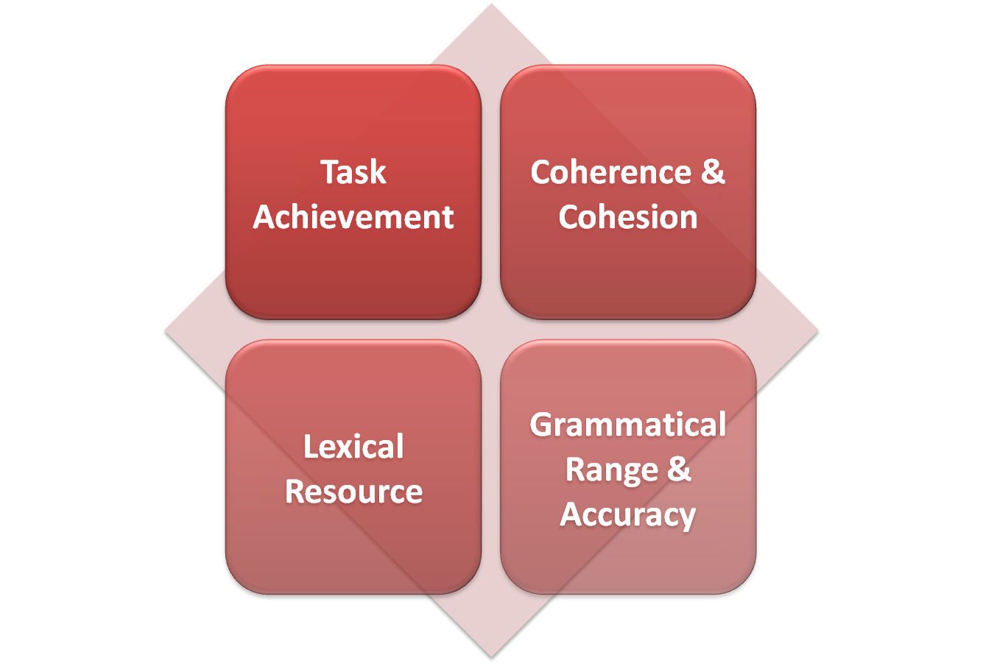
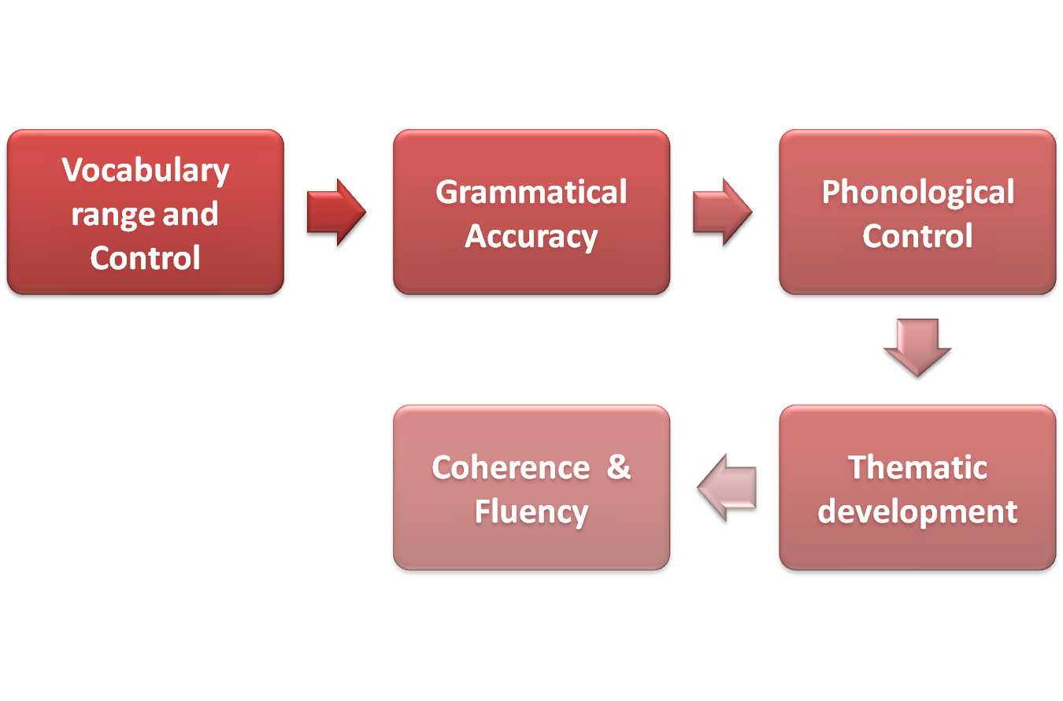
Evaluation Parameters
Writing Parameters
Speaking Rubrics

Slide 34
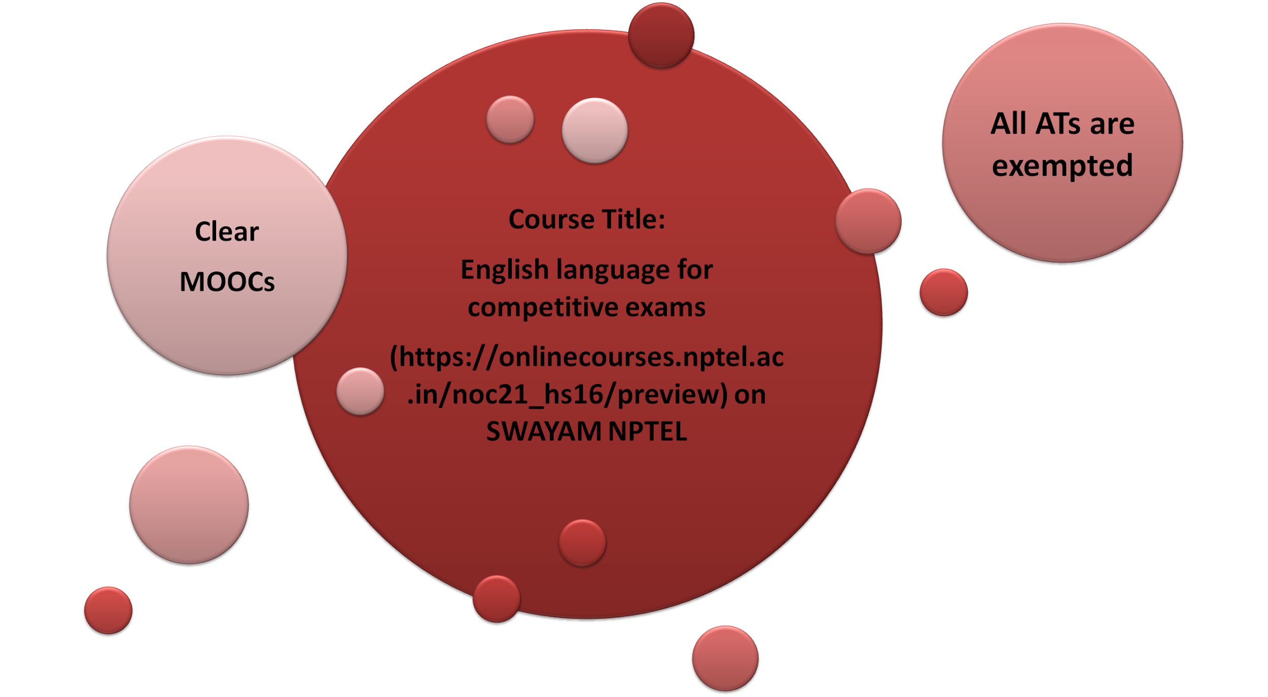
MOOCs/ Industry Certification/ National/ International competition or Tests:

Slide 35
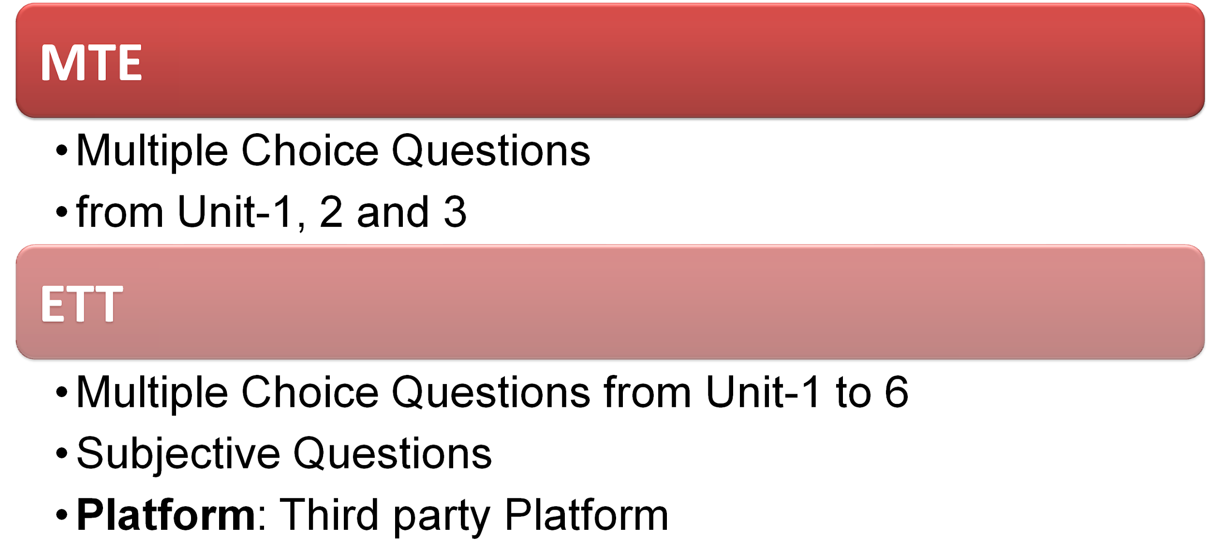
Complete Evaluation Criteria

Slide 36
Reference Books
R-2 : The Pearson Guide to Verbal Ability and Logical Reasoning for the CAT
Author : Nishit K. Sinha
Publisher : PEARSON

Slide 37

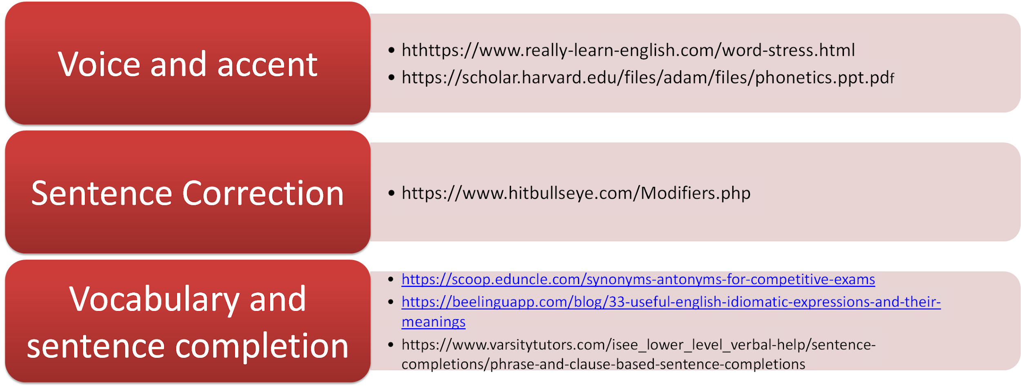
Content Resources:
Relevant Websites

Slide 38
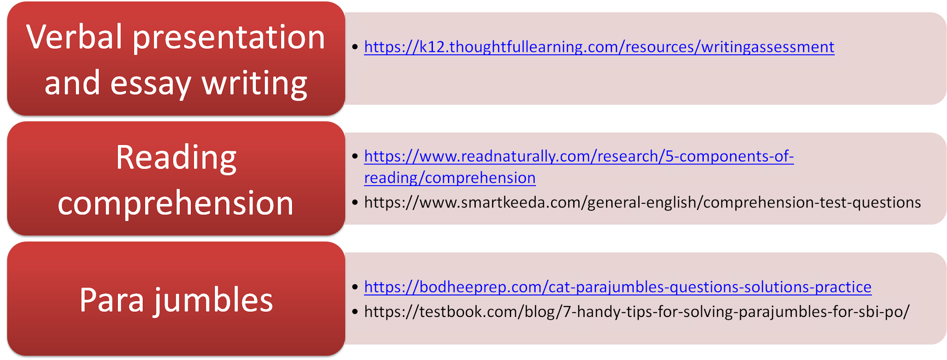
Content Resources:
Relevant Websites

Slide 39

Open Educational Resources

Slide 40
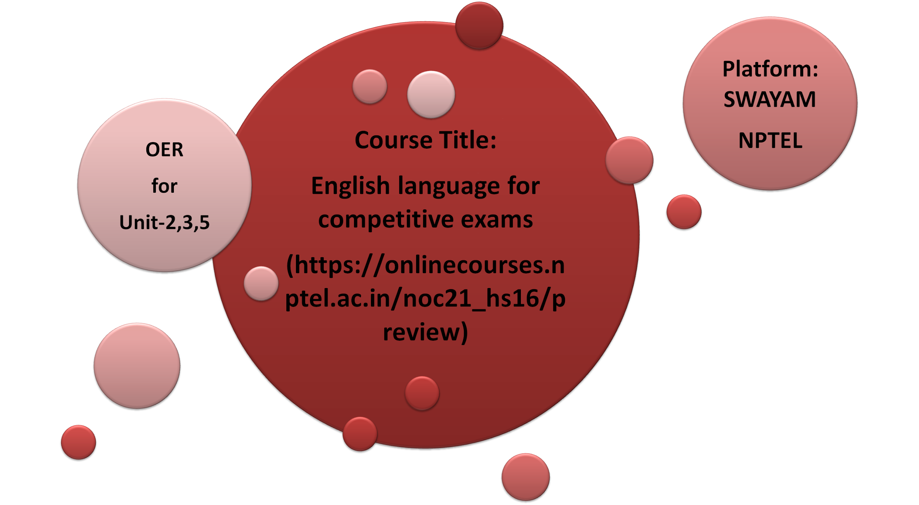
Open Educational Resources

Slide 41
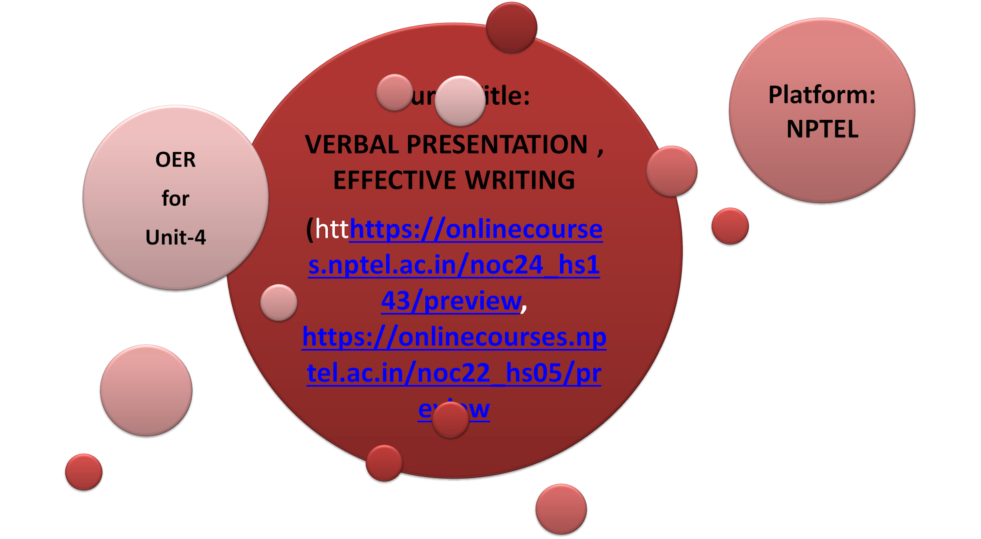
Open Educational Resources

Slide 42

Feedback Process

Slide 43

Feedback Process

Slide 44

Feedback Process

Slide 45




Skill Attainment
Ensured effective academic, professional, and social presence
Upgraded presentation skills
Enhanced grammatical and communicative competence
Efficacious written and verbal communication
Enriched personality
Upskilled vocabulary

Slide 46

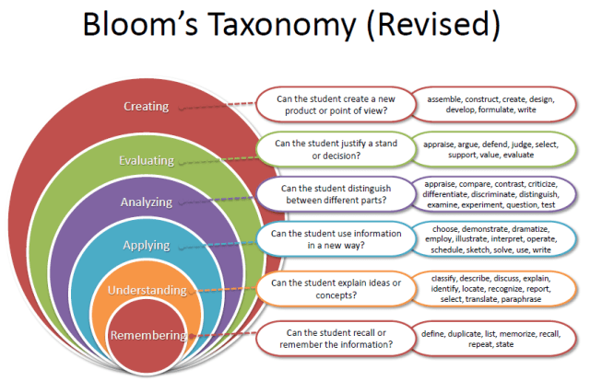
Revised Bloom’s Taxonomy

Slide 47

SCAN THE CODE & JOIN

Slide 48
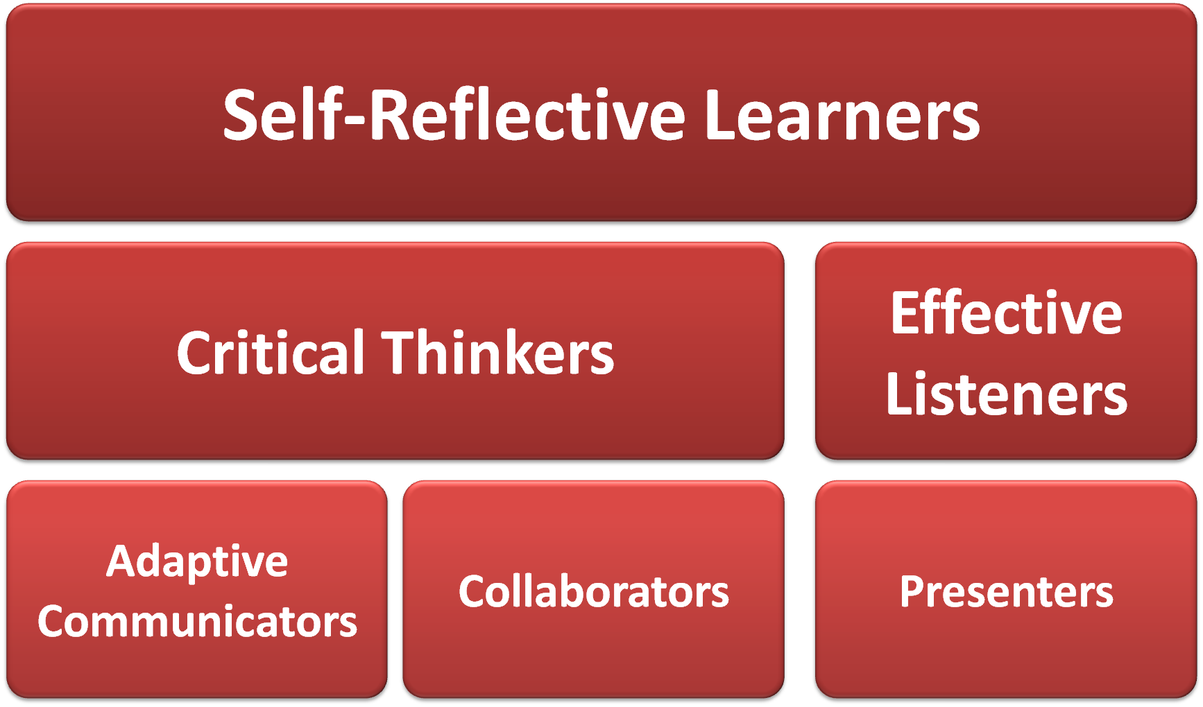
Students’ Roles

Slide 49
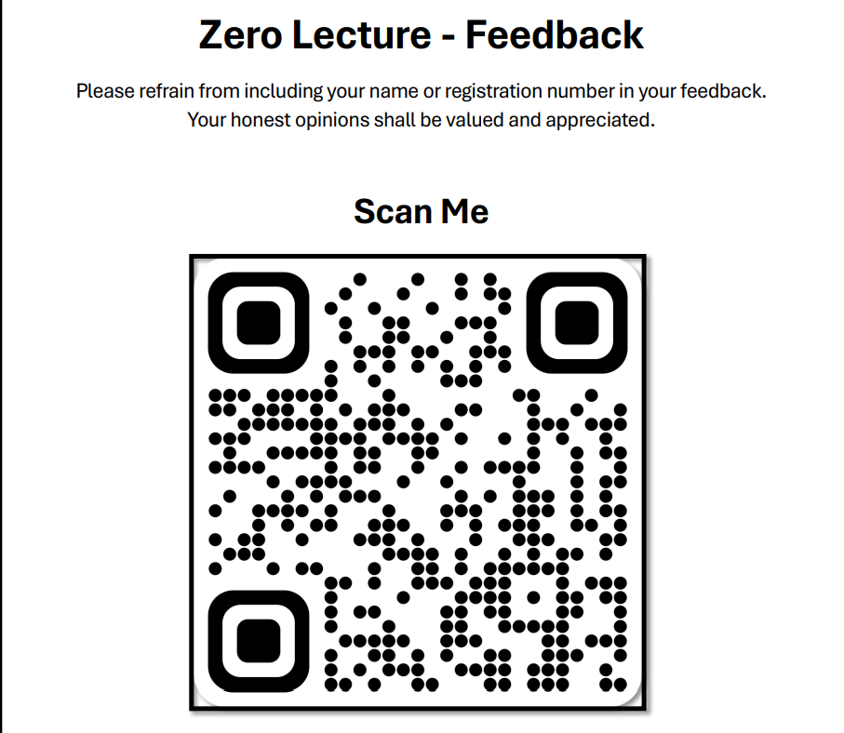

Slide 50
Thank You
All the Best!

